Slide 1

Metrics for HPC Data Center Power Proportionality and Efficiency
Natalie Bates
The First Workshop on HPC Power Management: Measuring Effectiveness
22 September, 2015
https://eehpcwg.llnl.gov/
Notes:
Thank you Neena and Chung-Hsing for organizing this workshop and inviting me to help frame today’s discussion.
Thanks also to everyone here for participating.
I am looking forward to learning from you.
You are all experts.
Everyone of you has expertise I don’t share.
We can all benefit from the unique insights and specific knowledge each person brings to this group.
This workshop provides a unique opportunity for us to learn from one another.
It is small and friendly and we have time to make new relationship and build on ones that are already established.

Slide 2
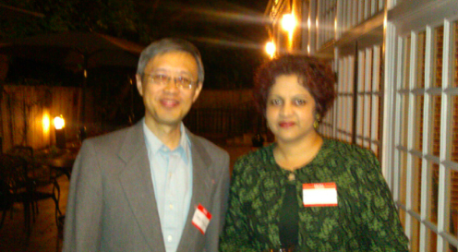
Learn from each other
Notes:
I hope these relationships -
those that are newly created or those building on the past-
will allow us to continue the opportunity
for sharing of advice, expertise and best practices
as well as taking collective action
to keep us moving forward in our drive for more energy efficient HPC.

Slide 3
What makes a good metric?
It matters.
But, metrics can have limitations.
“I don't see a real value in PUE.”
Gordon Lane, Facilities Coordinator at Petro Canada
LinkedIn Discussion on Power Usage Effectiveness (PUE)
Notes:
I am going to talk about energy efficiency metrics for HPC data centers.
I’d like to draw on my expertise in doing so- as Neena metioned, I have 20 years of management experience at Intel.
My experience at Intel was broad - spans engineering, research as well as manufacturing.
I used metrics in all of these diverse organizations.
Intel uses metrics extensively because metrics are extremely useful for effective management.
Those of you who have management experience probably already realize their value.
What makes a good metric?
It matters. A good metric helps you to do a great job managing your organization.
However, metrics have limitations.
Perhaps you have first hand knowledge and opinions about the limitations of PUE, the Green500 Flops per Watt and even about benchmarks like High Performance Linpack.

Slide 4
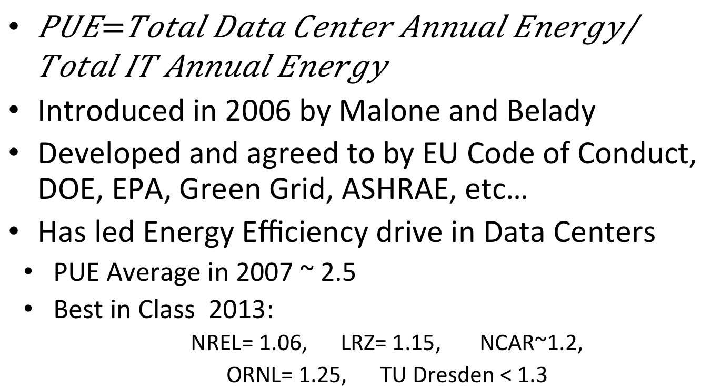
PUE
Introduced in 2006 by Malone and Belady
Developed and agreed to by EU Code of Conduct, DOE, EPA, Green Grid, ASHRAE, etc…
Has led Energy Efficiency drive in Data Centers
PUE Average in 2007 ~ 2.5
Best in Class 2013:
NREL= 1.06, LRZ= 1.15, NCAR~1.2,
ORNL= 1.25, TU Dresden < 1.3
… and in 2013 ~ 1.8
Notes:
Lets take a closer look at PUE.
It is almost 10 years old and has gained traction internationally.
When it first started, PUE was 2.5.
It was 1.8 in 2013.
And best in class PUEs were 1.3 and below.
NREL and others boast sub 1.1. This is excellent.
Clearly, there have been marked improvements in data center energy efficiency over the last 10 years.
PUE is a metric that has been used to track that improvement.
PUE might even have been a metric that helped to drive that improvement.
With PUEs approaching 1, however, its utility to track and drive improvement may be diminishing.

Slide 5
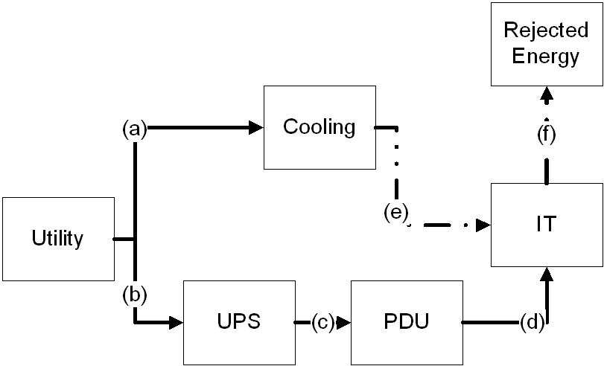

PUE Definition
Notes:
I think everyone here knows the definition of PUE, but here it is in case you need refreshing.
PUE is the ratio of total energy consumed by the data center divided by that portion of the energy that is consumed by the IT equipment.
So, the numerator includes energy for cooling, power distribution and other miscellaneous things like lighting, in addition to the energy consumed by IT equipment.
Whereas the denominator is simply the energy consumed by the IT equipment.
It is always greater than 1.

Slide 6
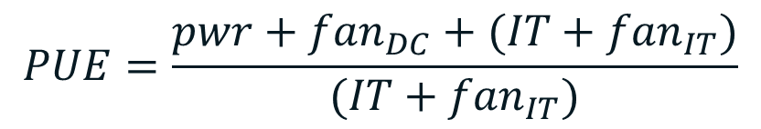
but PUE isn't perfect, consider…..
data center
UPS & PDU
pwr
fan
IT
fan
Notes:
One limitation of the PUE metric arises because IT equipment energy measurements may include energy used for cooling, like internal fans.

Slide 7
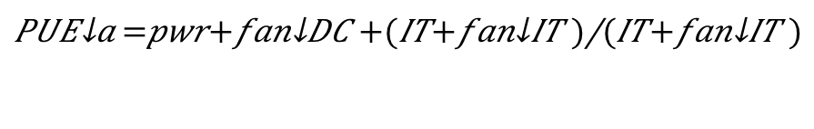
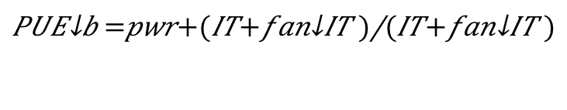

Three variations…
a)
both fans
$${PUE}_{a}=\frac{pwr+{fan}_{DC}+(IT+{fan}_{IT})}{(IT+{fan}_{IT})}$$
b)
IT
fans only
$${PUE}_{b}=\frac{pwr+(IT+{fan}_{IT})}{(IT+{fan}_{IT})}$$
c)
bldg
fan only
$${PUE}_{c}=\frac{pwr+{fan}_{DC}+IT}{IT}$$
PUE_{b} < PUE_{a} < PUE_{c} but is (b) best?
We don’t know….
Notes:
Take three very simple examples.
Data center A has external and internal fans.
Data center B has only internal fans.
Data center C has only external fans.
The PUE for Data Center B will be the lowest, or best.
The PUE for Data Center C would be the highest, or worst.
And the PUE for Data Center A would be in-between.
But, is Data Center B the most energy efficient? We don’t know. There isn’t enough information to answer this question.
Later today, Ram Nagappan will be talking about another metric, iTUE, that helps remove the ambiguity of whether or not fans are included in the IT measurements.
By the way, iTUE is a metric that has been developed by a team within the EE HPC WG.
The iTUE metric has been tested by various sites including Oak Ridge National Laboratory, Lawrence Livermore National Laboratory and the Leibniz Supercomputing Center.
The team is looking for other sites who are willing to test the metric, so please let me know if you are interested.

Slide 8
What makes a good metric?
Simple, measurable, actionable.
Tied to an objective and links with a clear goal.
It matters.
Metrics are indicators to be used as part of a continual improvement process.
Notes:
Limitations don’t make a bad metric, limitations are inherent in all metrics. The limitations have to be understood as part of using metrics.
So, again, what makes a good metric?
The answer is easy; a good metric is one that is simple, easy to measure, actionable and, most importantly, it has to matter.
In other words, a good metric should link strongly with a clear goal.
Metrics are indicators to measure and track progress towards objectives and goals.
They can be direct or indirect, quantitative or qualitative and they are generally most useful when they are used as part of a continual improvement process.

Slide 9
Continual improvement process
Set Objectives,
Goals and Metrics
Continual Improvement
Review Performance
Plan Improvements
Implement Changes
Notes:
Lets take a look at the continual improvement process.
The continual improvement process requires understanding key objectives, goals and setting metrics.
Then, planning for improvements, implementing changes, measuring results via metrics and reviewing performance.

Slide 10
Example “based on real story”
Reduce infrastructure overhead: measured by PUE
Maximize QoS and minimize TCO
Energy savings demonstrated
Dynamic controls for liquid cooling
Fixed to variable frequency drives
Notes:
Like in the movies, lets look at an example “based on a real story.”
There is a data center with the objective to minimize costs while ensuring high quality of service.
There might be multiple goals in support of that objective.
One goal may be to reduce data center infrastructure operational costs.
A metric in support of that goal might be PUE.
There may be many potential opportunities to achieve the goal.
This is where the story gets even more real.
One specific opportunity could be implementing dynamic controls for liquid cooling. This is a story that I think we’ll hear more about later today from Thomas Durbin at NCSA.
The NCSA data center went from using fixed frequency drives to using variable frequency drives in order to minimize the energy use in their chilled water pumps.
A performance review would assess whether the plan is successful as implemented. In Tom’s case, the energy cost savings were substantiated.
And, the reduced energy would also be captured in an improved PUE.

Slide 11

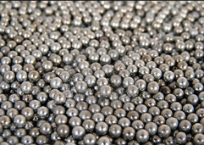
Energy efficiency improvements. No silver bullet…
… lots of silver BBs.
Notes:
Energy efficiency improvements are made of many incremental changes like the one I just described.
I argue that there is no silver bullet, just a lot of silver BBs.

Slide 12
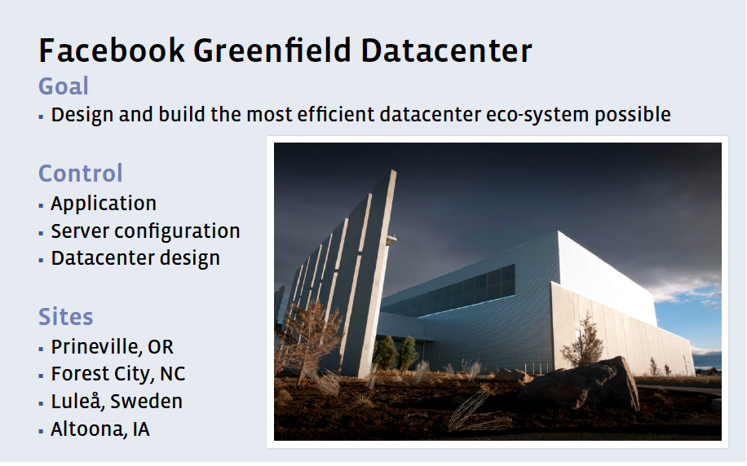
Facebook BBs include data centers
Notes:
The size of your BBs may vary depending upon your organization.
Last year, Charlie Manese from Facebook gave the keynote talk at the SC15 EE HPC WG Workshop.
He told us about the Facebook goal to design and build the most efficient datacenter eco-system possible.
Facebook is big. It has multiple sites and is continuing to grow.
So, Facebook has the opportunity to make continual improvements by designing and building new datacenters.
Some of you may have a greenfield opportunity and can start with a clean slate, but most of you are constrained by the need to improve an existing facility.
Greenfield or existing site, your objectives, goals and metrics will differ.
The differences between organizations is one reason that there is not one silver bullet.

Slide 13
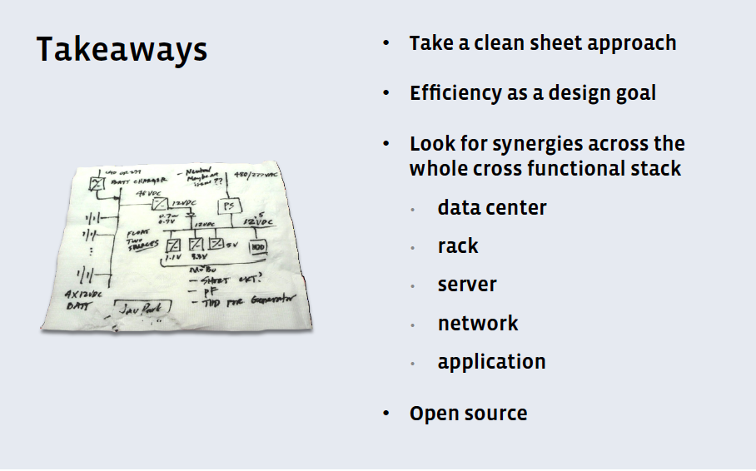
Look for synergies
Notes:
The Facebook presentation was very interesting. We can learn from the warehouse-sized cloud providers.
At the end of Charlie’s presentation, he urged us to look for synergies across the whole cross functional stack.
I think that this is very good advice.

Slide 14
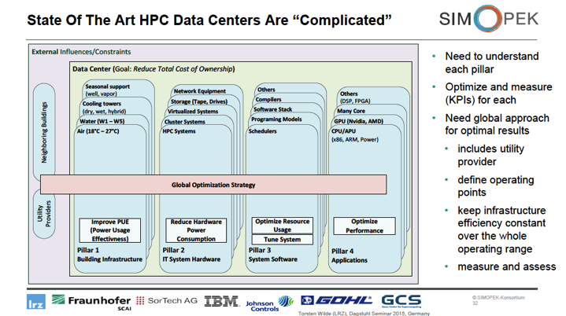
Four pillar framework
Slide curtesy of Torsten Wilde (LRZ) [www.simopek.de]; HPC Data Center Infrastructure Challenges Under A Power Bound, Dagstuhl Seminar 2015, Germany
Open Access 4 Pillar Framework Paper: http://www.springerlink.com/openurl.asp?genre=article&id=doi:10.1007/s00450-013-0244-6
Notes:
Looking for synergies is central to another helpful way of conceptualizing all parts of the HPC data center that influence its energy efficiency.
The “Four Pillar Framework for Energy Efficient HPC” formalizes the ‘synergies’ mentioned in the Facebook keynote.
It also highlights another reason that there isn’t a single silver bullet- data centers are complex. Notice the layers behind each of the four pillars.
This four pillar framework has been developed and used by the Leibniz Supercomputing Center- or LRZ- in Munich, Germany.
LRZ is a premier site in Germany for energy efficient HPC, similar to the position that the National Renewable Energy Laboratory’s Energy Systems Integration Facility has in the United States.
The HPC data center can be conceived as having four pillars; infrastructure, hardware, system software and applications.
There are also external influences, like utility providers and other campus buildings. Climate and weather should probably be there as well.
It is a holistic picture that allows for a synergistic approach to managing energy efficiency.

Slide 15
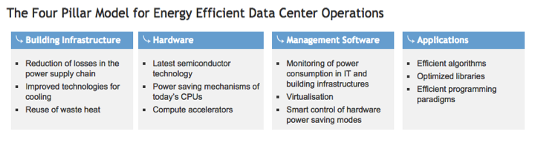
Green IT at Leibniz Supercomputing Centre
https://www.lrz.de/wir/green-it_en/
Notes:
LRZ has developed individual goals for each pillar and proposed different activities to achieve these goals.
One capability that spans all pillars is the ability to measure and monitor energy and power.
Without this capability, no system analysis can be done and without analysis, no optimization and, ultimately, no energy efficiency improvements are possible.
There are metrics or key performance indicators associated with the goals for each of these pillars.
For the Infrastructure pillar, the most well known metric is PUE.
There are others, such as ERE, CUE, WUE, and TUE.
These are all useful metrics, although some are more relevant than others for particular HPC centers.
ERE is only valuable to those who have a system for energy re-use, such as LRZ and NREL’s ESIF.

Slide 16
Useful constructs for energy efficiency improvements
Four pillar framework
Power, space and cooling (PSC) capability
Stranded and trapped capacity
PSC Capability: the availability of power, space, and cooling (PSC) to support HPC systems. Generally an HPC data center is built with the ability to expand, i.e., more PSC capability than initially required.
Notes:
Like the four pillar framework, PSC as well as stranded capacity and trapped capacity are useful constructs for improving capital and operational costs associated with the high and increasing power requirements of HPC data centers.
I have learned about these constructs from Neena, Chung-Hsing and Craig Barclay.
You’ll be hearing more about them as the day proceeds.
I find the constructs to be useful.
Perhaps there is an opportunity to write a paper about them- maybe an EE HPC WG team can collect case studies and write the paper?
Let me start with a definition of PSC Capability:
It is the availability of power, space, and cooling (PSC) to support HPC systems.
Generally an HPC data center is built with the ability to expand, i.e., more PSC capability than initially required.

Slide 17
Stranded and trapped capacity
Stranded Capacity: That which results from the HPC data center having uneven capability of power, space or cooling (PSC) resources to support additional HPC systems.
Trapped Capacity: occurs when the workload does not use the intended PSC that has been allocated to it.
Notes:
Here are definitions for Stranded and Trapped capacity.
Stranded Capacity: That which results from the HPC data center having uneven capability of power, space or cooling (PSC) resources to support additional HPC systems.
For example, there might be sufficient power and cooling but insufficient space.
Stranded capacity is more likely to be exposed as total load approaches maximum load.
Trapped Capacity: occurs when the workload does not use the intended PSC that has been allocated to it.

Slide 18
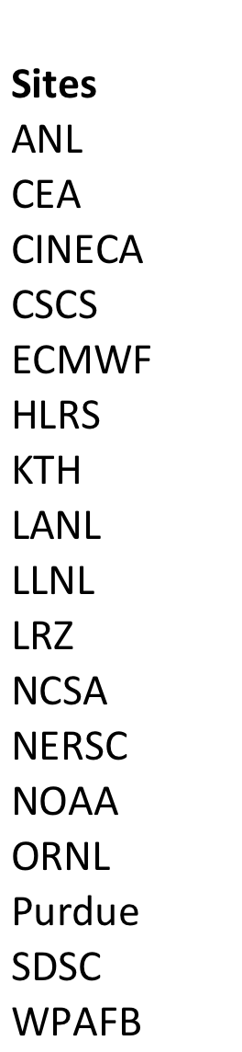
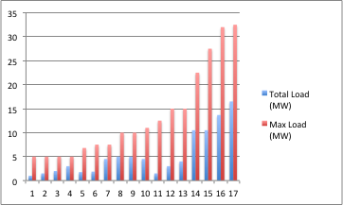
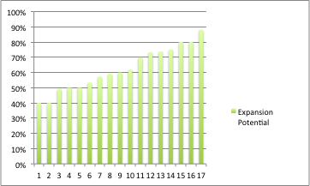
Lots of PSC capability…
Capability to more than double load
Total load = as defined by PUE
Max load = theoretical peak energy
Based on EE HPC WG Survey, 2014
… possibly stranded capacity.
Notes:
I’m going to use some data collected by the EE HPC WG Demand Response Team to help illustrate this planned ability to expand. This data is from a sample of Top50 Supercomputer centers in Europe and the United States.
The blue and red lined chart shows the difference between total load and theoretical peak load for 17 different data centers. Total Load was asked to be the same number used when calculating PUE, as defined by The Green Grid WP#49. Max Load is the facility's theoretical peak energy, as the infrastructure is currently fit up.
As an example, Lawrence Livermore National Laboratory is position #17 on the chart with red and blue lines. LLNL has a total load of 16.5MW and a Max load of 32MW.
The green lined chart is the expansion potential – or percent ratio max load and total load.
On the green line chart, Livermore is in position #3. They have the ability to double their load. Livermore’s PSC is relatively low.
You can see that almost all of the sites have the ability to more than double their load. There is clearly a lot of PSC capability in these supercomputer centers.
What isn’t clear is if there is stranded capacity. We didn’t ask for that information
When asking for this data, the EE HPC WG team tried to clarify the definition of max load.
Perhaps there is an opportunity to be more clear about Max Load by asking for PSC capabiity?

Slide 19
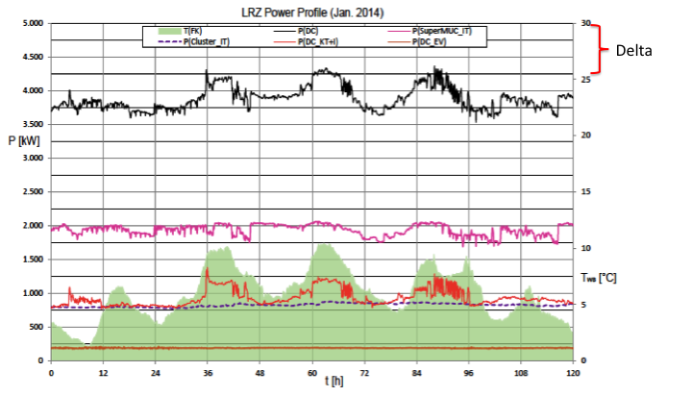
Typical load less than fit-up
Data provided by Detlef Labrenz and Torsten Wilde from Leibniz Supercomputing Centre (LRZ)
Notes:
This data from the LRZ HPC data center helps to identify potentially trapped capacity.
The total load of the LRZ HPC data center is 5MW.
The black line is total facility power. As you can see, the facility normally runs between 3.5MW and 4.5MW.
The 0.5MW difference between the facility fit up and normal peak power draw may be an example of trapped capacity.
It may be that the facility could successfully operate at 4.5MW and that the additional expenses incurred with fitting up the facility to operate at 5.0MW could have been avoided.
It may also be that LRZ is deliberately operating with a typical load less than the fit-up. We don’t know.
Coupling stranded and trapped capacity can be devastating.

Slide 20

Notes:
Think about this plight…
Its not bad enough that I’m stranded,
Now I’m trapped in an invisible box.
Thanks, I’m delighted that you laughed at this joke.
Or,
Oh well. Maybe my daughter was right. My nerd jokes make me a joke nerd.

Slide 21
Four pillar framework
Slide curtesy of Torsten Wilde (LRZ) [www.simopek.de]; HPC Data Center Infrastructure Challenges Under A Power Bound, Dagstuhl Seminar 2015, Germany
Open Access 4 Pillar Framework Paper: http://www.springerlink.com/openurl.asp?genre=article&id=doi:10.1007/s00450-013-0244-6
Notes:
We’ve established the importance of setting objectives, goals and metrics for energy efficient HPC.
We’ve explored constructs- like the four pillar model as well as stranded and trapped capacity.
How can we work to identify and reduce stranded and trapped capacity?

Slide 22
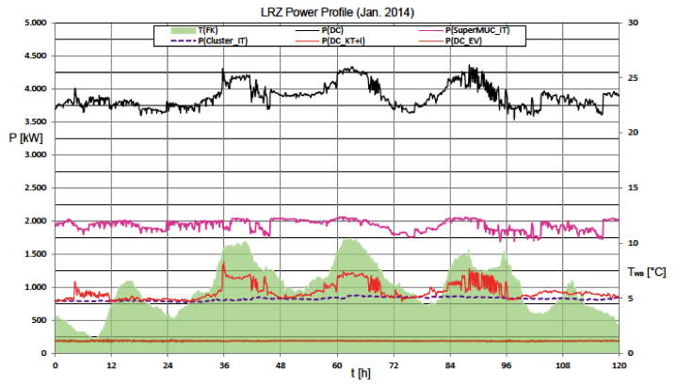
Investigating improvement opportunities
Total power tracks SuperMUC power
Total power tracks cooling power
Cooling power tracks wetbulb T
Challenges for energy efficiency when operating complex cooling infrastructures
Data provided by Detlef Labrenz and Torsten Wilde from Leibniz Supercomputing Centre (LRZ)
Notes:
LRZ is investigating what causes the variation in normal peak power between 3.5MW and 4.5MW?
The pink line is the power variability of LRZ’s largest supercomputer, the SuperMUC. Clearly the black and pink lines track - the facility variability is partially a result of the power draw of the SuperMUC.
There are some additional peaks and swings that do not come from the supercomputer.
They don’t come from the electrical distribution and conversion either, which is the orange line on the bottom. And they don’t come from the cluster, which is the purple line two up from the bottom.
The green shading on the bottom is a profile of wet-bulb temperatures- changes in weather.
The red line is the power draw of the cooling system.
There is clearly a relationship between wet-bulb temperature and the efficiency of the cooling infrastructure.
This raises some questions; why does the cooling infrastructure behave like this?
Can the power spikes and power oscillations of the cooling infrastructure be avoided in order to be more power and energy efficient?
LRZ is investigating the possibility of improving their chiller-less cooling loop for specific real-world operating points.

Slide 23
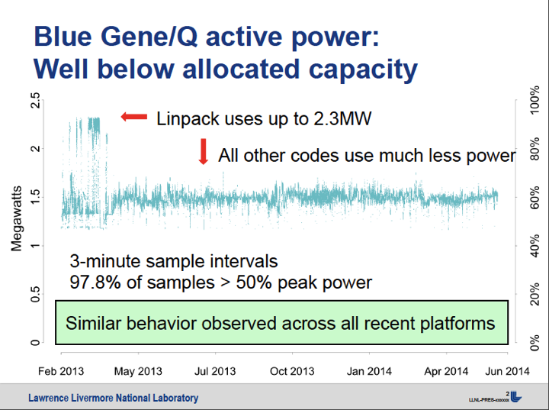
Contributors to trapped capacity
Content provided courtesy of Barry Rountree, LLNL
Notes:
Here is data from Lawrence Livermore National Laboratory that suggests another contributor to power variability and potentially trapped capacity.
Other than a few benchmarks like Linpack and SystemBurn, most applications do not use the system resources heavily enough to reach peak power loads.
This is over a year’s data on one of LLNL’s systems.
The power was sampled every three minutes.
You can see that the system peak load – as shown during a Linpack run- is rarely seen with the normal application profile.

Slide 24
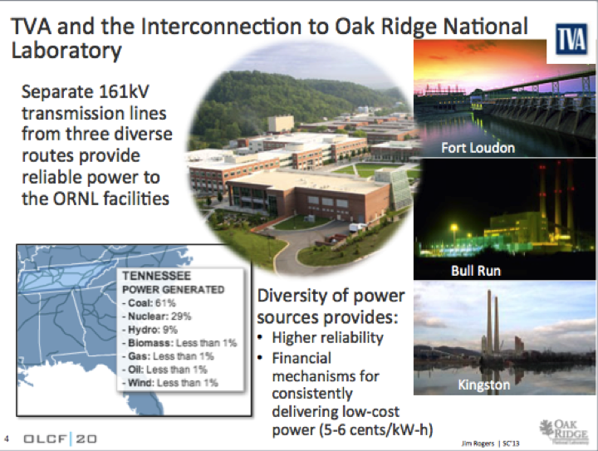
Electricity provider impacts
Content provided courtesy of Jim Rogers, ORNL at SC13 EE HPC WG Workshop
Notes:
The environmental conditions of Supercomputing Centers vary and can significantly impact objectives for power and energy management. Lets look at ORNL.
If you have any questions or want further information on this, please talk to Jim Rogers. He is the one who presented this material at the SC13 EE HPC WG Workshop. Thank you Jim for letting me speak to material from your presentation.
Oak Ridge National Laboratory is fed with large transmission lines from three different routes to provide very reliable power at a consistently low price.

Slide 25
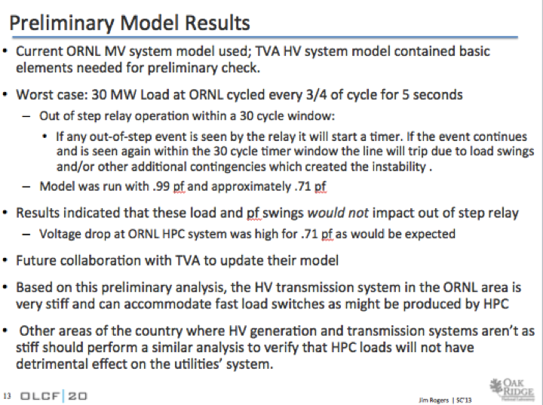
Stiff and accommodating
Content provided courtesy of Jim Rogers, ORNL at SC13 EE HPC WG Workshop
Notes:
ORNL did an analysis to determine the sensitivity of their provider to fast load switches produced by HPC. They determined that the high voltage transmission in the ORNL area is very stiff and can accommodate these fast-load switches.
THey do advise other sites to do a similar analysis. Not all electricity providers can accommodate such fast load switches.

Slide 26
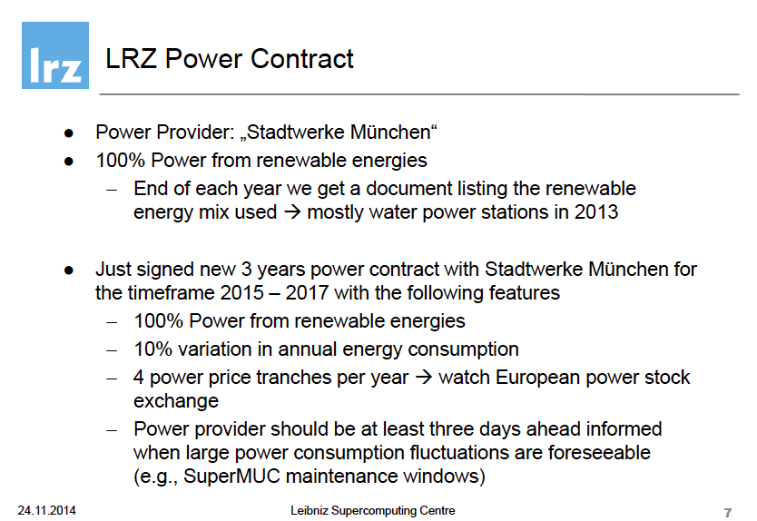
Sensitivities and flexibility
Content provided courtesy of Herbert Huber, LRZ at SC13 EE HPC WG Workshop
Notes:
LRZ is facing a very different electricity provider. They are
required to stay within a 10% variation in annual energy consumption
must notify power provider at least two days in advance, if expect large power fluctuations
has to pay surcharges if power falls below or exceeds contracted power band in a 15 minutes average
ORNL is motivated to reduce energy and hence their operational costs.
LRZ, on the other hand, is financially incentivized to control both power and energy.
As a result, their objectives, goals and metrics may differ as well.

Slide 27
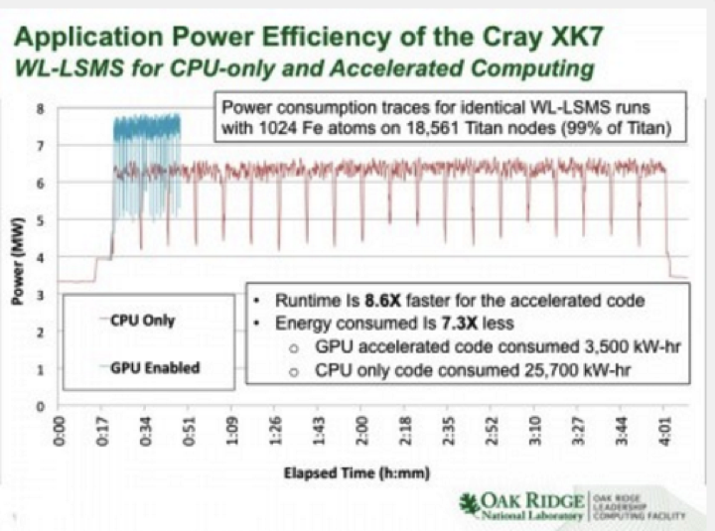
Energy efficient and higher power
Source: https://www.olcf.ornl.gov/2014/08/20/titan-proves-to-be-more-energy-efficient-than-its-predecessor/
Notes:
How might these different environmental conditions translate to different objectives and goals? Lets look at an example.
This data is from the Titan supercomputer, at Oak Ridge National Laboratory.
The blue and red lines are power profiles for identical runs of a thermodynamics code.
The blue line run is GPU enabled and the red line run is CPU only.
The energy consumption improves by more than 7 times with GPU enabling
However, note that the peak power and power variability requirements are greater with GPU enabling than they are with CPU only.
Peak power increased by more than one MW and power variability increased by more than one half MW.
This may be because the GPU has very sophisticated power management features. The GPU is ready to go in an instant, ramping both frequency and power. However, when it’s idle, it almost powers itself down.
Regardless of the cause, the net effect is that less energy is used to get the same work done, but with higher power draw and greater power variability.
This is a win for ORNL, but perhaps less so for sites with other contracts that incentivize power as well as energy management.

Slide 28
Key take-aways
Continually improve
Use metrics that ‘matter’
Understand four pillar synergies
Find stranded and trapped capacity
Notes:
I’d like to review what I’ve covered so far before moving on to my closing thoughts on metrics.
All HPC data centers have an enormous opportunity to:
continually improve their energy efficiency
with a barrage of silver bullets
Using metrics that are mapped to their particular objectives and goals
And can leverage this activity by using a
synergistic approach
with a focus on finding stranded and trapped capacity.

Slide 29
No single metric,
Identify and prioritize HPC center energy parameters for dashboards
Identify potential stakeholder(s) for each of the energy parameters
Document recommendations to assist the HPC community to choose the parameters they want to monitor and manage
… but a list to choose from.
Notes:
I’ve emphasized that there isn’t a single silver bullet, but now I’m going to suggest that there might be a limited number of metrics that HPC data centers are likely to find ‘matter’ for them.
Several years ago, the EE HPC WG Dashboard team developed a list of energy parameters that were deemed high priority for effective management of HPC data centers.
I hope that today’s workshop will help to test these lists.

Slide 30
The list is stakeholder dependent
Director – Responsible for the overall center’s activity
Facility Manager – Primarily responsible for the physical infrastructure
Information Technology Manager – Primarily responsible for the information technologies (hardware & software) in the data center
Notes:
We considered three different stakeholders with lists tailored to their perspectives.
The stakeholders included the Director- someone in a position like the one that Jim Rogers holds at ORNL.
Next was the facility manager- perhaps a list tailored to someone in a position like the one held by Thomas Durbin at NSCA.
The third stakeholder was called the Information Technology Manager.
I imagine this to be like the System Administrator.
Do we have anyone here who might consider them position they’re in to be an Information Technology Manager? How about System Administrator?

Slide 31
Facility manager’s items
Item | Primary Information | Unit | Priority
1 | Total power/energy | kW & kWh | High
2 | IT Power /energy | kW & kWh | High
3 | Power Usage Effectiveness -Power | Index | High
4 | Power Usage Effectiveness- Energy | Index | High
5 | Cooling Efficiency | kW/ton | High
6 | Cooling Energy Use | kWh | High
7 | Data center IT equipment cooling diagram | degF/C | High
8 | Temperature (map) | degF/C | High
9 | UPS input / output power /Energy | kW & kWh | High
10 | Data center electrical distribution diagram |  | High
11 | CRAC/CRAH/AHU RAT (avg, min, max) | degF/C | High
12 | CRAC/CRAH/AHU SAT (avg, min, max) | degF/C | High
Notes:
This is the list of items developed for the facility manager.
I have recently tested this list against dashboards that Kevin Regimbal sent to me from NREL’s ESIF facility.
It maps fairly well with NREL’s dashboards.
BTW, I’ve included these dashboards in the back-up of this presentation for your review. Feel free to use it a springboard for dashboards in your organization.

Slide 32
Systems manager’s items
Item | Primary Information | Unit | Priority
1 | Energy Cost per data processing unit | $/unit | High
2 | Total power/energy | kW & kWh | High
3 | IT Power /energy | kW & kWh | High
4 | Average IT utilization-Compute System | Percent | High
5 | Power Usage Effectiveness –Power | Index | High
6 | Power Usage Effectiveness- Energy | Index | High
7 | IT efficiencyª | Work output/W* | High
8 | Data center IT equipment cooling diagram | degF/C | High
ª Depends on how each HPC center defines its work output
Notes:
The system manager list is shorter than that of the facilities manager.
Perhaps this list needs supplementing? Perhaps its brevity reflects the facilities-centric view of the dashboard team that developed it?
Should it include things like average energy to solution or optimal power/performance frequency- from an application perspective?

Slide 33
Director’s items
Item | Primary Information | Unit | Priority
1 | Total power & energy | kW & kWh | High
2 | Energy cost | $ | High
3 | Average IT utilization-Compute System | Percent | High
4 | Power Usage Effectiveness –Power | Index | High
5 | Power Usage Effectiveness- Energy | Index | High
6 | IT efficiency ª | Work output/Watt | High
ª Depends on how each HPC center defines its work output
Notes:
Finally, here are the items that we felt were key to the director.
Note that the definition of “work output” is assumed to be different across HPC data centers.

Slide 34
It is time to update these lists
Today’s workshop and ensuing report
SC15 BoF “Identifying a Few, High-Leverage Energy Efficiency Metrics”
General Recommendations for High Performance Computing Data Center Energy Management Dashboard Display, Sartor, D. et al.
http://doi.ieeecomputersociety.org/10.1109/IPDPSW.2013.272
Notes:
I hope that this workshop will help review and update these lists.
I think that Neena and Chung-Hsing are willing and planning on generating a report based on this outcomes of this workshop.
Perhaps that report could include updated versions of these lists?
Then, Neena, Chung Hsing, Dale Sartor from LBNL and Torsten Wilde from LRZ have organized a Birds of Feather at SC15.
The output of this workshop should form the basis for that BoF.
This seems like a good opportunity for effective collaboration and progress on defining a high-leverage energy efficiency metrics for HPC.

Slide 35

Mobilize the community to accelerate energy efficient HPC
Explore innovative approaches
Peer to peer exchange
Share best practices
Take collective action
http://eehpcwg.llnl.gov
natalie.jean.bates@gmail.com
EE HPC WG
~600 Members
20+ countries
50% GOV
30% COM
20% EDU
Notes:
I’ve mentioned the EE HPC WG.
Is there anyone here who isn’t already on the membership list?
If yes, I’ll take a few minutes to the group.

Slide 36
Energy Efficient HPC Working Group
Unique inter-disciplinary
And organizational blend
EE HPC WG
~550 Members
20+ countries
50% GOV
30% COM
20% EDU
HPC Systems
Data Centers
Broader Engagement

Slide 37
Open, virtual and accessible
Membership criteria: interest in energy efficient HPC
EE HPC WG
~550 Members
20+ countries
50% GO
HPC Systems
Data Centers
Meetings
Webinars
Workshops
BoFs
Papers
Documents
Website
Linked-In
Broader Engagement
Notes:
We are open, mostly virtual and very accessible.
The only membership criteria is interest in energy efficient HPC
Caveat- not a vehicle for product promotion.
We use teleconference meetings and webinars.
For face-to-face interaction, we leverage major supercomputing conferences such as SC and ISC.
Our physical output is papers, documents, our website and a linked-in group.

Slide 38
SC15 events
EE HPC WG Booth
6th Annual Workshop for the Energy Efficient HPC Working Group (EE HPC WG) 9-5:30 Monday, November 16
Keynote, Justin Rattner, CTO Intel (retired)
Opening Remarks, Satoshi Matsuoka, Tokyo Institute of Technology
Japanese Supercomputing Center Perspectives
Oil & Gas Industry Panel
Lessons learned from NREL, Dresden and LANL
BoF “Identifying a Few, High-Leverage Energy Efficiency Metrics”
BoF “Dynamic Liquid Cooling, Telemetry and Controls; Opportunity for Improved TCO?”
BoF “The Green500 List and its Continuing Evolution”
Paper “Node Variability in Large-Scale Power Measurements: Perspectives from the Green500, Top500 and EEHPCWG”
Notes:
Finally, I’d like to invite you to participate in our SC15 events.

Slide 39
Thank you!
Questions?
http://eehpcwg.llnl.gov
natalie.jean.bates@gmail.com

Slide 40
Back-up

Slide 41
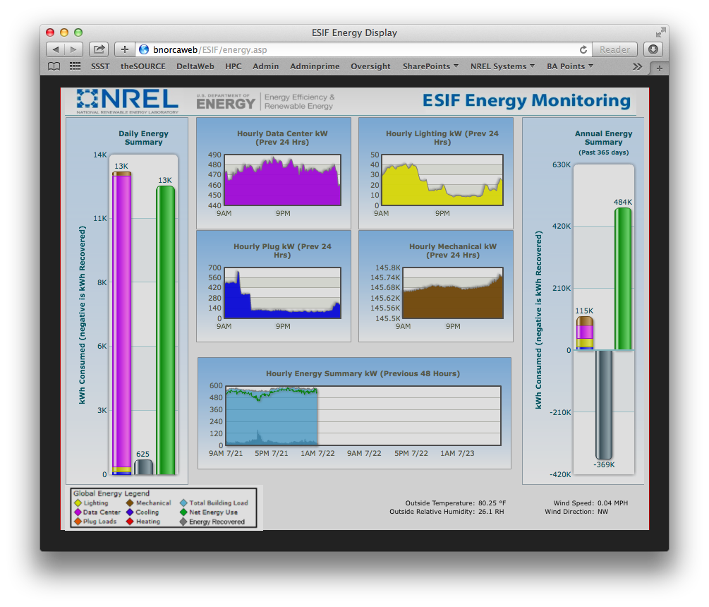

Slide 42
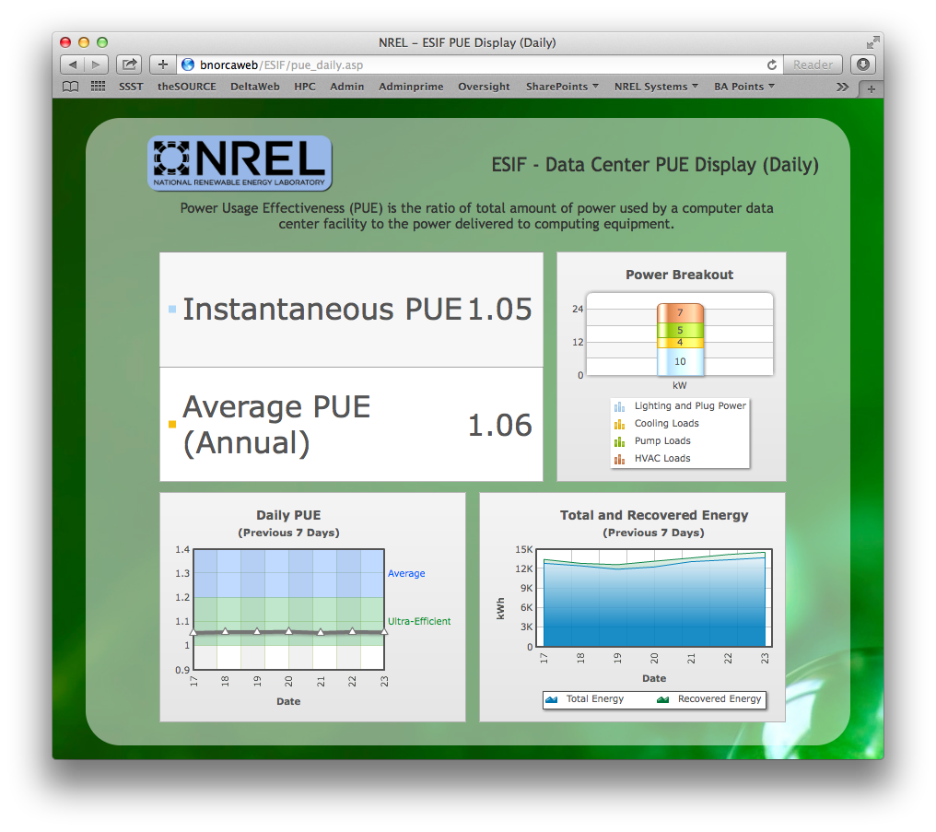

Slide 43
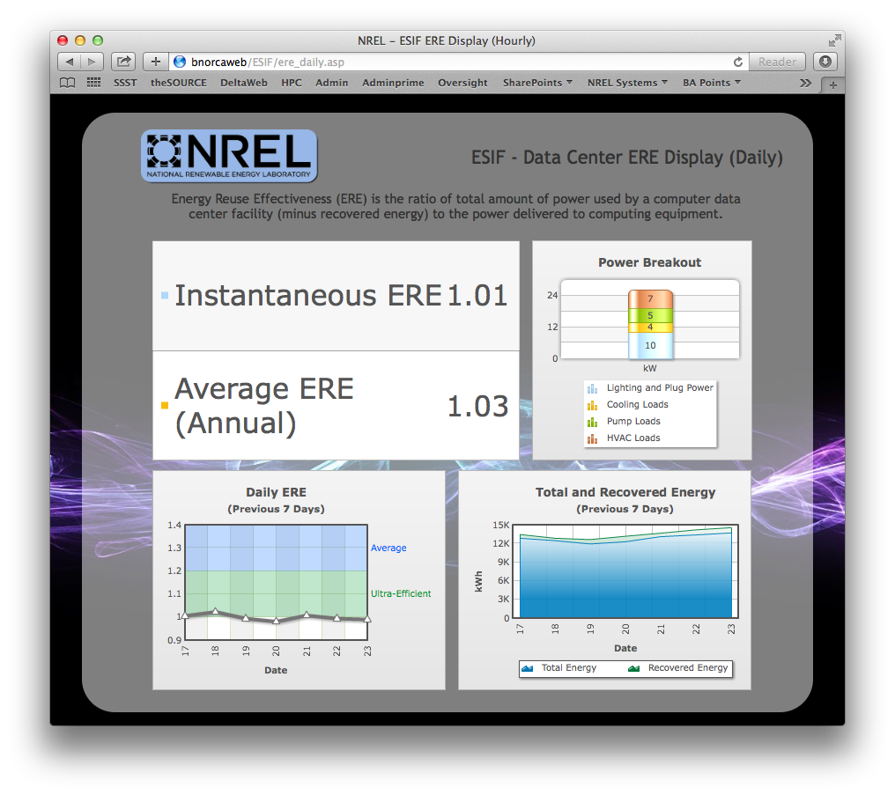

Slide 44
